Slide 1
Infosys Springboard Virtual Internship 6.0
Title: NeuroFleetX – AI Driven Urban Mobility Optimization

Slide 2
Abstract:
NeuroFleetX is a Java-based AI-driven system designed to optimize urban transportation. The system collects and analyzes real-time traffic, GPS, and vehicle data to predict congestion and suggest the most efficient routes for drivers and fleet managers. By leveraging artificial intelligence, it reduces travel time, saves fuel, and helps city planners manage traffic effectively. The platform provides a user-friendly dashboard that enables real-time monitoring and smart decision-making, improving overall urban mobility and commuter experience.

Slide 3
Objective:
The main objective of the FleetX project is to build a smart and automated vehicle management system that enhances efficiency, reduces delays, and provides analytical insights through AI.
FleetX focuses on intelligent route planning, live tracking, trip history management, and automated alerts. The system provides a reliable backend using Spring Boot and a clean user interface for both admin and driver modules. It ensures data consistency, faster response, and optimized resource utilization within fleet management.

Slide 4
Problem Statement:
In cities, traffic jams are a big problem. People waste time, fuel, and money while pollution keeps increasing. Current traffic systems are not smart enough to handle sudden changes like accidents, road blocks, or peak hours. This creates delays for both private vehicles and public transport. There is a need for an intelligent system that can use real-time data to predict traffic and suggest better routes.

Slide 5
Proposed System:
FleetX proposes an intelligent backend system developed using Spring Boot and MySQL to manage all vehicle and trip-related data efficiently.
The system is designed with multiple modules for admin, drivers, and users, each performing specific operations.
Admin can register vehicles, assign drivers, and view trip analytics, while drivers can access their assigned trips and update trip progress.
Through AI algorithms, the system optimizes routes and predicts estimated time and fuel consumption. It also generates analytics and predictive notifications, ensuring proactive management of vehicles.

Slide 6
System Architecture:
The system architecture of FleetX is divided into four main layers — Frontend, Backend, Database, and AI Engine.
The Frontend (developed using React or a simple web UI) interacts with users, allowing them to log in and manage vehicles.
The Backend, powered by Spring Boot, handles the logic, data validation, and communication between modules.
The Database Layer (MySQL) stores structured information such as vehicle details, trip logs, and driver data.
Finally, the AI Layer processes historical trip data to optimize routes and generate intelligent analytics.
This layered architecture ensures scalability, modularity, and maintainability.

Slide 7
Workflow:
The FleetX system workflow begins when the admin logs in to the web portal and registers all vehicles, drivers, and routes.
Drivers receive their trip assignments and can view estimated time and distance.
Once a trip begins, the backend continuously records trip data and updates the system.
The AI module analyzes these data points to predict future route efficiency, estimated fuel consumption, and overall fleet performance.
The admin can view all this information in a dashboard that displays statistics, alerts, and reports, allowing for smarter decision-making.

Slide 8
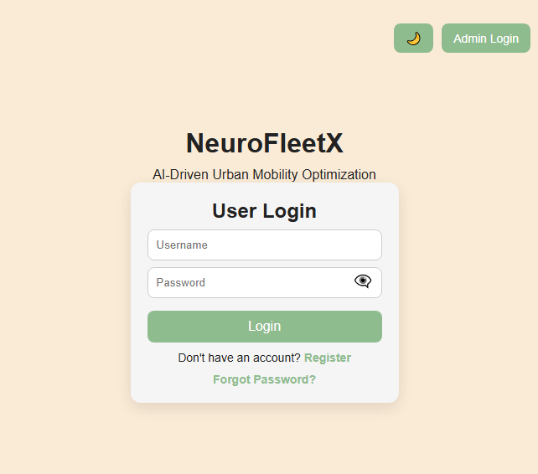
Login page:
The entry point for users. It's a self-contained form that handles multiple modes (user login, admin login, registration, and password reset). It communicates back to grant access to the main dashboard

Slide 9
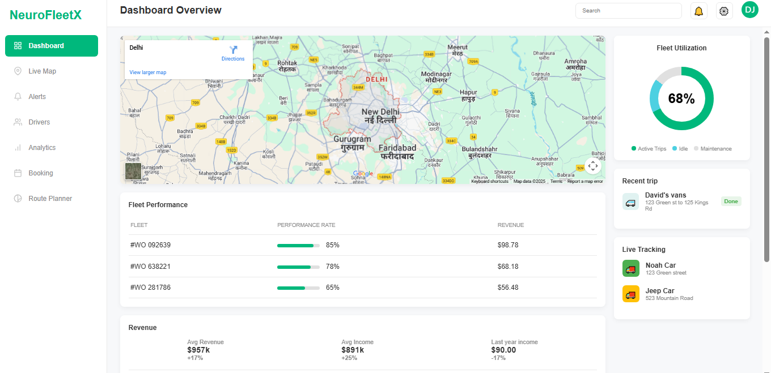
Dashboard:
The main landing page after logging in. It presents a high-level overview of the fleet's status using various widgets, including a map, performance metrics, revenue charts, and live tracking information

Slide 10
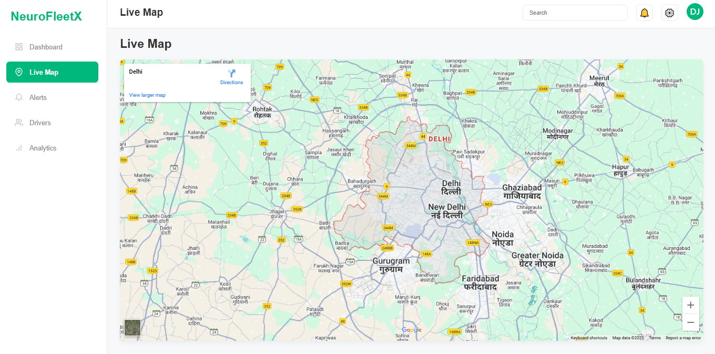
Live Map:
A dedicated page for a full-screen, real-time map view of all vehicles in the fleet.

Slide 11
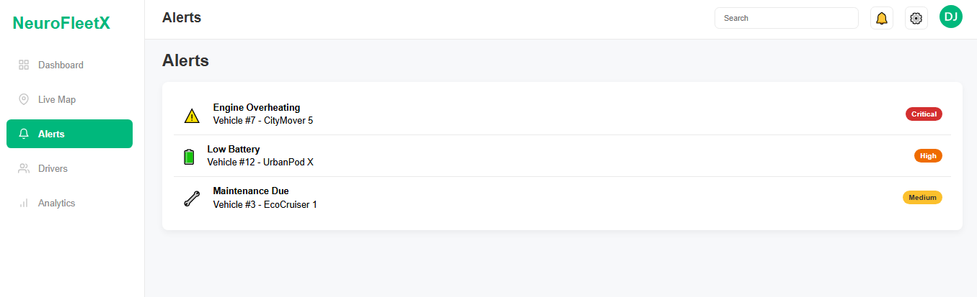
Alerts:
This section displays critical notifications about the fleet. It's designed to show not only current issues (like overheating) but also predictive alerts, a key AI feature of your application.

Slide 12
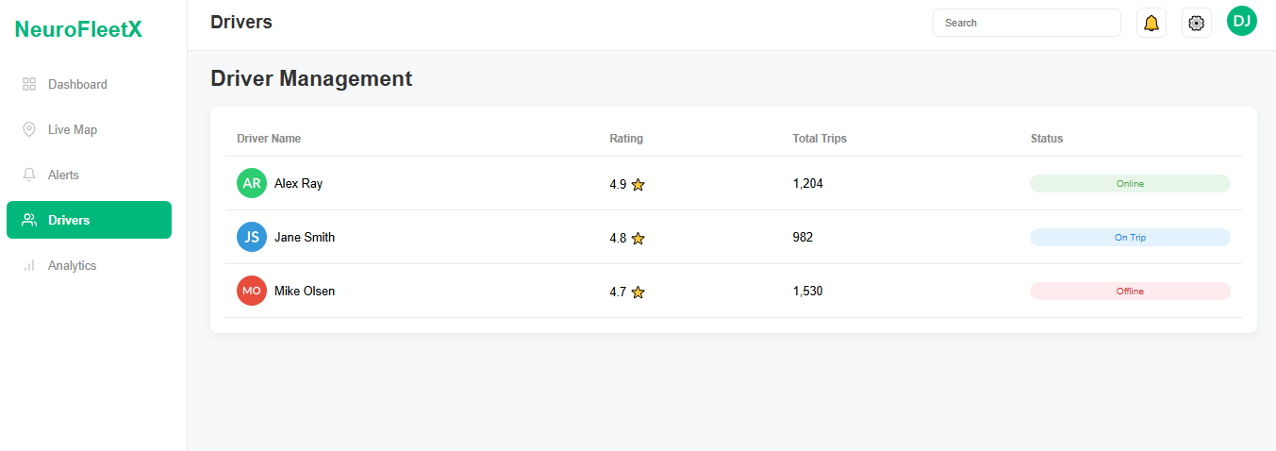
Drivers:
A management page that displays a list of all drivers, their ratings, trip counts, and current status (Online, Offline, On Trip).

Slide 13
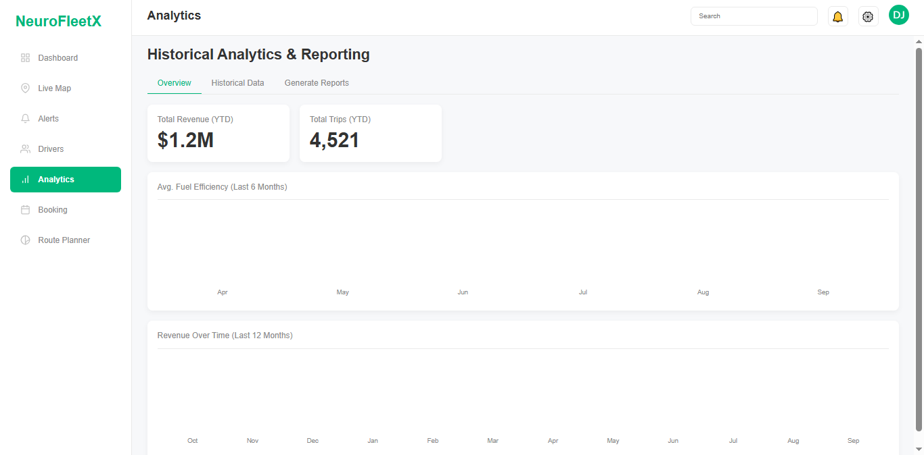
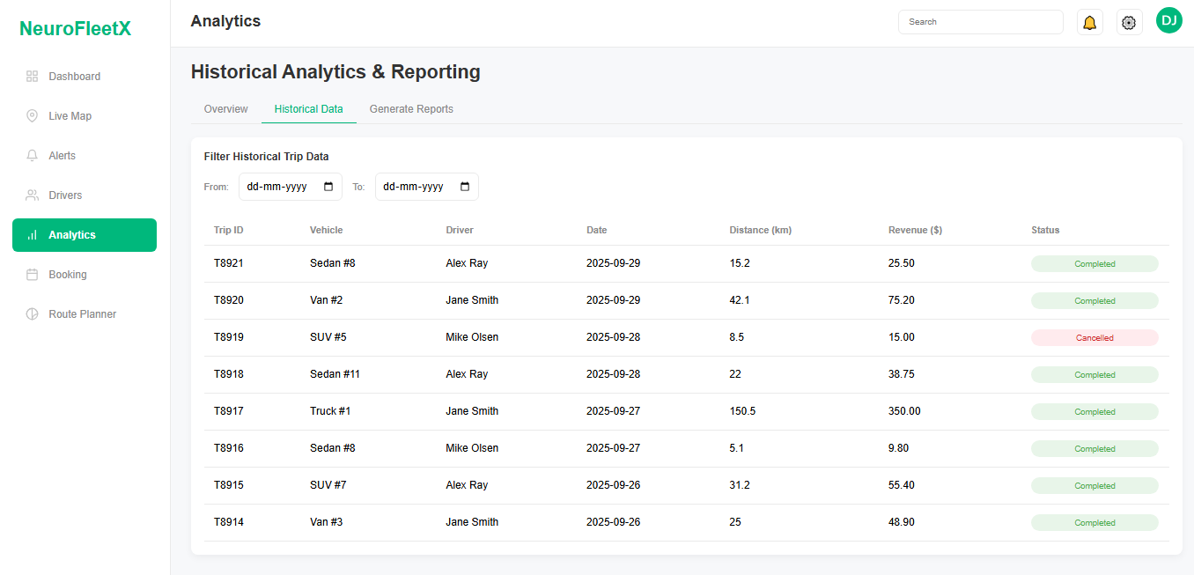
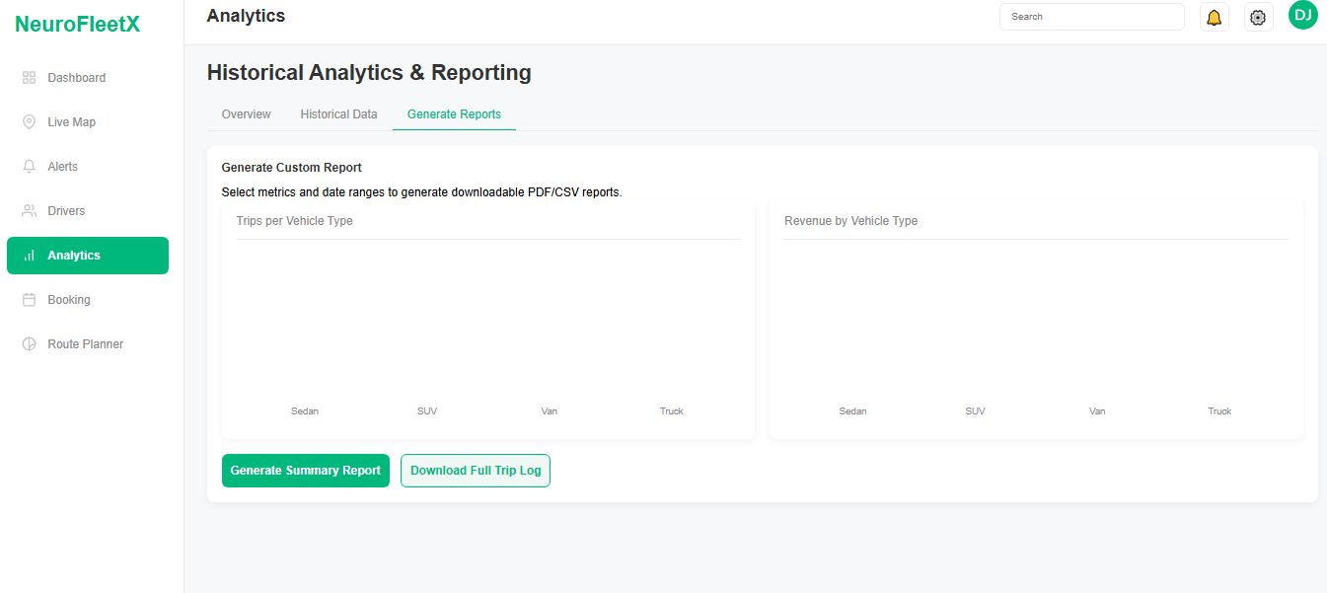
Analytics:
A powerful data analysis and reporting section with multiple tabs: Overview: Shows key performance indicators (KPIs) and visual charts for revenue and fuel efficiency. Historical Data: Contains a detailed, filterable table of past trips. Generate Reports: Allows users to generate and download summary reports or the full trip log as a CSV file.

Slide 14
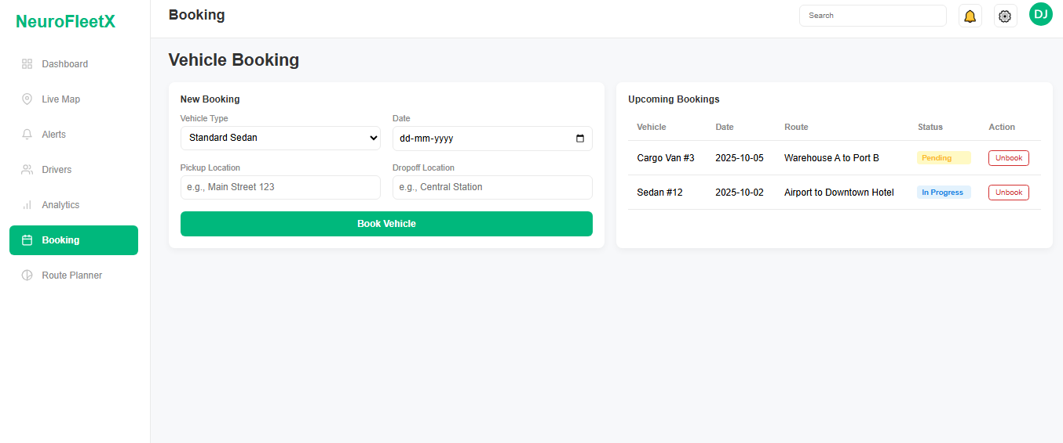
Bookings:
An interactive section for managing vehicle reservations. Users can fill out a form to book a new trip, and the "Upcoming Bookings" table updates in real-time. It also includes functionality to cancel ("unbook") a reservation.

Slide 15
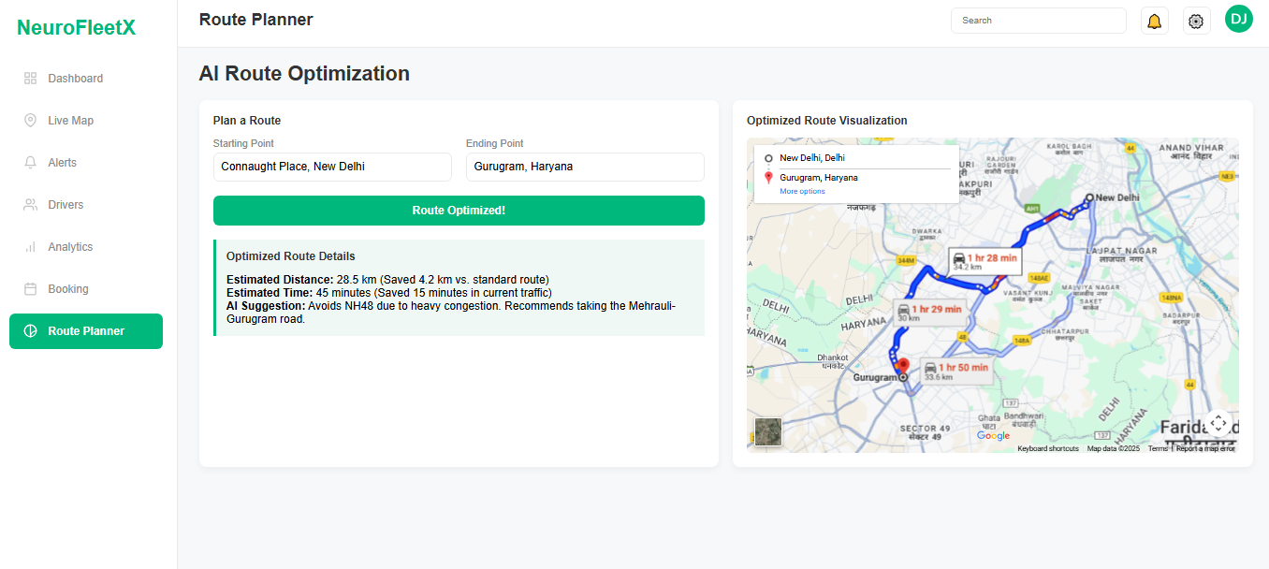
Route Planner:
Demonstrates the AI route optimization feature. A user can input a start and end point, and the system displays an AI-optimized route on a map, highlighting time and distance savings.

Slide 16
Key Features:
FleetX includes several key features designed to enhance automation and intelligence in fleet operations.
It offers AI-based Route Optimization that automatically determines the shortest or fastest route based on distance and conditions.
Vehicle Management allows easy addition, modification, and monitoring of vehicle information.
The Historical Analytics module provides detailed performance reports of previous trips.
Smart Alerts notify administrators of possible delays or vehicle maintenance needs.
The Estimated Time & Distance Module helps in planning and executing trips more efficiently, while Revenue Analytics tracks profits and trip costs in real time.

Slide 17
Results:
FleetX successfully establishes backend connectivity, data storage, and intelligent analytics.
The system is capable of executing all CRUD operations such as adding, updating, and deleting vehicles or trips.
It calculates estimated time and distance efficiently and stores the results in the database.
The project outputs include REST APIs for vehicle and trip management, live analytics dashboards, and alert generation for administrators.
Overall, FleetX demonstrates high performance, scalability, and automation in vehicle management systems.

Slide 18
Conclusion:
FleetX proves that artificial intelligence can revolutionize fleet and trip management systems.
By integrating smart analytics, route optimization, and automation, the project offers a practical and scalable solution for transportation challenges.
It reduces manual effort, increases efficiency, and ensures real-time control over vehicle operations.
The successful implementation of FleetX highlights the importance of AI and IoT in modern transportation networks.

Slide 19
Thank you

